Slide 1
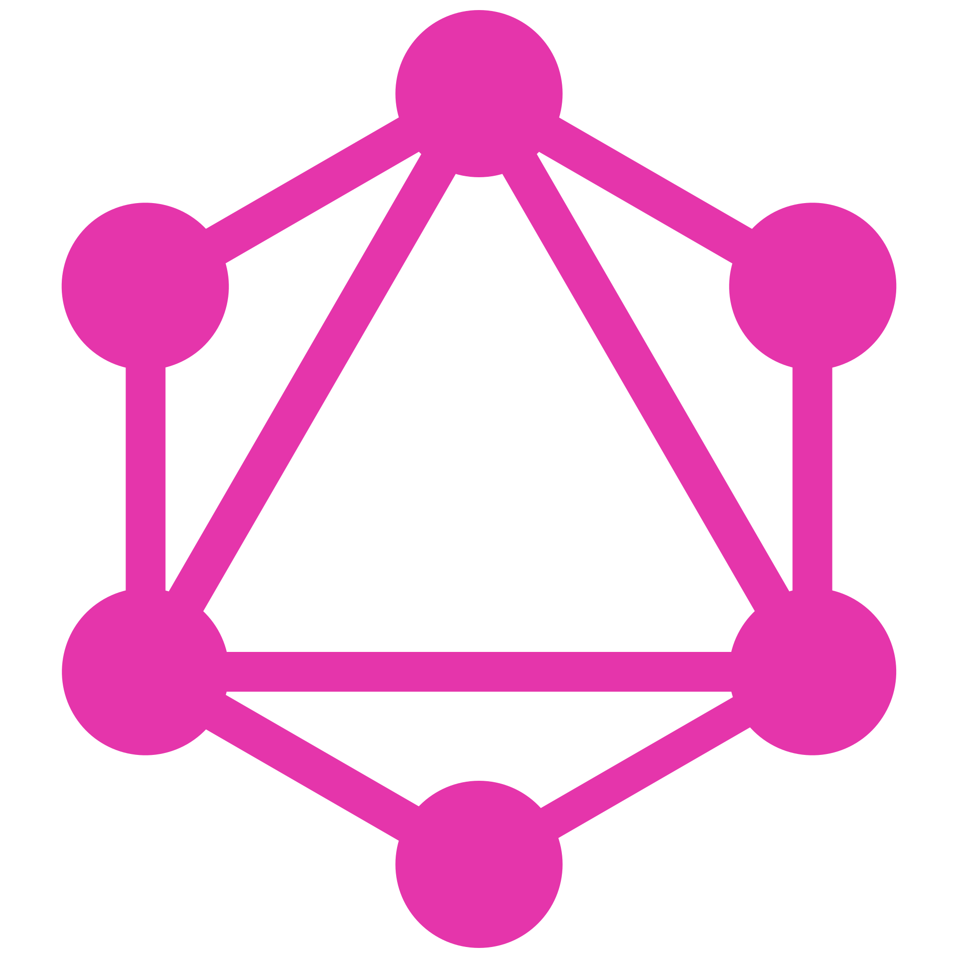
GraphQL Introduction
What is GraphQL : Why Use GraphQL : GraphQL vs Rest :
Who Uses GraphQL : GraphQL Development Tools : Working Demo

Slide 2
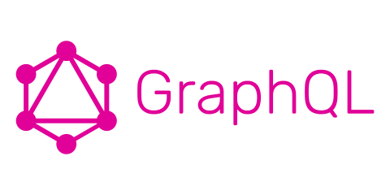
What is GraphQL?

Slide 3
What is GraphQL?
Created by:
Nick Schrock
Dan Schafer
Lee Byron
Open-Sourced in 2015
In November 2018 the GraphQL Project was moved to the newly-established GraphQL foundation hosted by the non-profit Linux Foundation
Created by a Facebook internal development team in 2012

Slide 4
What is GraphQL?
Created by a Facebook internal development team in 2012
GraphQL is a query language for APIs
Instead of multiple endpoints to retrieve data, a query is sent to one endpoint and the response only includes what was asked for
Query:
query {
player(id: 1) {
playerName
}
}
Response:
{
"data": {
"player": {
"playerName": "Phil Mickelson"
}
}
}

Slide 5
What is GraphQL?
Created by a Facebook internal development team in 2012
GraphQL is a query language for APIs
Based on the idea of Schemas
The center of any GraphQL implementation
Defines the way the data is structured with object types and fields
Describes the functionality available to the clients that connect
Creates the relationships between types
Handles the data input validation for querying and mutating data
Large schemas can be broken down into smaller more manageable and scoped schemas

Slide 6
What is GraphQL?
Created by a Facebook internal development team in 2012
GraphQL is a query language for APIs
Based on the idea of Schemas
type Query {
healthCheck: Message!
}
type Mutation {
addPlayer(playerName: String!): Player!
}
type Message {
code: String!
message: String!
}
type Player {
id: Int!
playerName: String!
}

Slide 7
What is GraphQL?
Created by a Facebook internal development team in 2012
GraphQL is a query language for APIs
Based on the idea of Schemas
Gives clients the power to ask for exactly what they need and nothing more
Clients have the power to only ask for what they need
Only the fields and related data objects in the query are returned.
Allows to get multiple related data objects with one request saving on the amount of api calls required
Server only has to process the data asked for, so if a more costly calculation is part of the data object the server only needs to make that calculation if requested.

Slide 8
What is GraphQL?
Created by a Facebook internal development team in 2012
GraphQL is a query language for APIs
Based on the idea of Schemas
Gives clients the power to ask for exactly what they need and nothing more
Makes it easier to evolve APIs over time
GraphQL Schema makes it easy to visualize your data structures which in turn minimize accidental breaking changes
Adding fields or relationships to types won’t break the original functionality.
You can evolve your API without versioning
Continuous Evolution
API evolution is the concept of striving to maintain the “I” in API, the request/response body, query parameters, general functionality, etc., only breaking them when you absolutely, absolutely, have to.
Phil Sturgeon

Slide 9

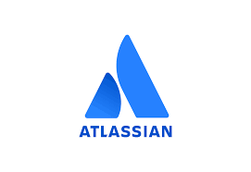









Who is Using GraphQL?

Slide 10
Why Use GraphQL?

Slide 11
Why Use GraphQL?
GraphQL is fast
You only request the data you need.
Any data fields with more overhead are only requested when they are needed.
Only the relationship data that has been requested is returned.
Getting the related data you need in one call saving you the many API requests normally required to get the data needed.
Instead of the server deciding what to send back the client makes the decision.

Slide 12
Why Use GraphQL?
GraphQL is fast
GraphQL is flexible
Probably it’s biggest advantage
Ask only for what you need and only get back what you ask for
Desktop or Web Apps with larger screens may want to load more data since there is more screen real estate to use.
While the Mobile Apps have much smaller screens and can only display the basic data.
The server only has to do the minimal amount of processing to satisfy the specific platform.

Slide 13
Why Use GraphQL?
GraphQL is fast
GraphQL is flexible
GraphQL is easy to use and easy to maintain
New data fields and relational data can be added without introducing a breaking change.
Simply add the field to the schema
May not even have to modify the resolver
For relational data simply add an object resolver
Everything will work just as before. The new fields and data can then be implemented in the client as needed

Slide 14
Why Use GraphQL?
GraphQL is fast
GraphQL is flexible
GraphQL is easy to use and easy to maintain
GraphQL has native support for subscriptions (PubSub)
With graphql subscriptions are easy and built-in
Use resolvers much as you would in your other query and mutation resolvers.
(the demo has an example of this in action)

Slide 15
GraphQL Operations?
GraphQL uses three types of operations (or query types): Query, Mutation, and Subscription

Slide 16
GraphQL Operations?
The query type is used to retrieve information from the API.
This example gets the player with id of 1 and returns some player fields, a list of rounds, and course data.
query {
player(id: 1) {
id
playerName
rounds {
roundDate
score
course {
courseName
}
}
}
}
Query

Slide 17
GraphQL Operations?
Query
Mutation
Mutation queries are used to “mutate” the data. This replaces the create, update, and delete operations of a REST API.
This example creates a player and sets the playerName.
mutation {
addPlayer (playerName: "Jimi Hendrix"){
id
playerName
}
}

Slide 18
GraphQL Operations?
Query
Mutation
Subscription
Subscriptions allow the client so subscribe to a channel. When there is an update that publishes to the subscription the client will be notified.
The client also has the ability to choose what will be returned
subscription {
roundUpdated(roundId: 1) {
id
roundDate
player {
playerName
}
}
}

Slide 19
GraphQL Operations?
Query
Mutation
Subscription
Resolvers (not an operation, but worth mentioning here)
Resolvers are not operations, but they are the part that makes the operations functional.
It doesn’t matter if it’s a Query or Mutation it is backed by a Resolver.
A Resolver is basically the function that is called when the operation is called.
The data needed for the Resolver to do its job is injected into the function.
function(parent, args, ctx, info) => {
// Do work here
// Examples shown in demo
}

Slide 20
GraphQL vs. Rest

Slide 21
GraphQL vs. Rest
GraphQL
Rest
Architecture: | client-driven | server-driven

Slide 22
GraphQL vs. Rest
GraphQL
Rest
Architecture: | client-driven | server-driven
Organized in Terms of: | schema and type system | endpoints

Slide 23
GraphQL vs. Rest
GraphQL
Rest
Architecture: | client-driven | server-driven
Organized in Terms of: | schema and type system | endpoints
Operations: | query, mutation, subscription | create, read, update, delete

Slide 24
GraphQL vs. Rest
GraphQL
Rest
Architecture: | client-driven | server-driven
Organized in Terms of: | schema and type system | endpoints
Operations: | query, mutation, subscription | create, read, update, delete
Data Fetching: | specific data with single call | fixed data with multi calls

Slide 25
GraphQL vs. Rest
GraphQL
Rest
Architecture: | client-driven | server-driven
Organized in Terms of: | schema and type system | endpoints
Operations: | query, mutation, subscription | create, read, update, delete
Data Fetching: | specific data with single call | fixed data with multi calls
Community: | growing | large

Slide 26
GraphQL vs. Rest
GraphQL
Rest
Architecture: | client-driven | server-driven
Organized in Terms of: | schema and type system | endpoints
Operations: | query, mutation, subscription | create, read, update, delete
Data Fetching: | specific data with single call | fixed data with multi calls
Community: | growing | large
Performance: | fast | multi network calls takes time

Slide 27
GraphQL vs. Rest
GraphQL
Rest
Architecture: | client-driven | server-driven
Organized in Terms of: | schema and type system | endpoints
Operations: | query, mutation, subscription | create, read, update, delete
Data Fetching: | specific data with single call | fixed data with multi calls
Community: | growing | large
Performance: | fast | multi network calls takes time
Development Speed: | rapid | slower

Slide 28
GraphQL vs. Rest
GraphQL
Rest
Architecture: | client-driven | server-driven
Organized in Terms of: | schema and type system | endpoints
Operations: | query, mutation, subscription | create, read, update, delete
Data Fetching: | specific data with single call | fixed data with multi calls
Community: | growing | large
Performance: | fast | multi network calls takes time
Development Speed: | rapid | slower
Self Documenting: | yes | no

Slide 29
GraphQL vs. Rest
GraphQL
Rest
Architecture: | client-driven | server-driven
Organized in Terms of: | schema and type system | endpoints
Operations: | query, mutation, subscription | create, read, update, delete
Data Fetching: | specific data with single call | fixed data with multi calls
Community: | growing | large
Performance: | fast | multi network calls takes time
Development Speed: | rapid | slower
Self Documenting: | yes | no
File Uploads: | no* | yes

Slide 30
What is a Graph?

Slide 31
What is a Graph?
playerName
roundsCount (calculated)
coursesCount (calculated)
courses (relationship)
rounds (relationship)
Player

Slide 32
What is a Graph?
playerName
roundsCount (calculated)
coursesCount (calculated)
courses (relationship)
rounds (relationship)
Player
roundDate
(calculated) score
(relationship) player
(relationship) course
(relationship) holes
Round

Slide 33
What is a Graph?
playerName
roundsCount (calculated)
coursesCount (calculated)
courses (relationship)
rounds (relationship)
Player
roundDate
(calculated) score
(relationship) player
(relationship) course
(relationship) holes
Round
number
Score
(relationship) round
(relationship) course
(relationship) courseHole
Round
Hole

Slide 34
What is a Graph?
playerName
roundsCount (calculated)
coursesCount (calculated)
courses (relationship)
rounds (relationship)
Player
courseName
city
state
zip
roundsCount (calculated)
par (calculated)
rounds (relationship)
holes (relationship)
players (relationship)
roundDate
(calculated) score
(relationship) player
(relationship) course
(relationship) holes
Round
Course
number
Score
(relationship) round
(relationship) course
(relationship) courseHole
Round
Hole

Slide 35
What is a Graph?
playerName
roundsCount (calculated)
coursesCount (calculated)
courses (relationship)
rounds (relationship)
Player
courseName
city
state
zip
roundsCount (calculated)
par (calculated)
rounds (relationship)
holes (relationship)
players (relationship)
roundDate
(calculated) score
(relationship) player
(relationship) course
(relationship) holes
Round
Course
number
Score
(relationship) round
(relationship) course
(relationship) courseHole
Round
Hole
Course
Hole
number
par
handicap

Slide 36
What is a Graph?
playerName
roundsCount (calculated)
coursesCount (calculated)
courses (relationship)
rounds (relationship)
Player
courseName
city
state
zip
roundsCount (calculated)
par (calculated)
rounds (relationship)
holes (relationship)
players (relationship)
roundDate
(calculated) score
(relationship) player
(relationship) course
(relationship) holes
Round
Course
number
Score
(relationship) round
(relationship) course
(relationship) courseHole
Round
Hole
Course
Hole
number
par
handicap

Slide 37
What is a Graph?
The Players Example
query {
player(id: 2) {
id
playerName
}
}

Slide 38
What is a Graph?
The Players Example
query {
player(id: 2) {
id
playerName
}
}
{
"data": {
"player": {
"id": 2,
"playerName": "Phil Mickelson"
}
}
}

Slide 39
What is a Graph?
The Players Example with Related Data
query {
player(id: 2) {
id
playerName
rounds {
roundDate
score
course {
courseName
}
}
}
}

Slide 40
What is a Graph?
The Players Example with Related Data
query {
player(id: 2) {
id
playerName
rounds {
roundDate
score
course {
courseName
}
}
}
}
{
"data": {
"player": {
"id": 2,
"playerName": "Phil Mickelson",
"rounds": [
{
"roundDate": "2019-09-01",
"score": 92,
"course": {
"courseName": "SunRiver Golf Club"
}
},
...
]
}
}
}

Slide 41
GraphQL Development Tools
Relay - A JavaScript framework for building data-driven React applications powered by GraphQL
Prisma - Prisma is a database abstraction layer that turns your databases into GraphQL APIs with CRUD operations and real time capabilities
Vue-GraphQL - A GraphQL client for the vue framework
GraphQL Editor - Build, manage and collaborate on your schema
GraphQL Playground - A GraphQL IDE for quick building and testing queries
GraphQL Voyager - Create a data relational view of your data using your GraphQL Schema
GraphQL Docs - A static documentation generator using your GraphQL Schema

Slide 42
Languages with GraphQL Implementations
PHP
Graphql-PHP : https://github.com/webonyx/graphql-php
Graphql-Laravel : https://github.com/rebing/graphql-laravel
GraphQLBundle (symfony) : https://github.com/overblog/GraphQLBundle
Node
GraphQL-Yoga : https://github.com/prisma/graphql-yoga
Apollo-Server : https://github.com/apollographql/apollo-server/tree/master/packages/apollo-server-express
Python
Graphene : https://github.com/graphql-python/graphene
Perl
GraphQL-Perl : https://github.com/graphql-perl/graphql-perl
GoLang
GraphQL-Go : https://github.com/graphql-go/graphql

Slide 43
Working Demo
The demo is a Golf players round tracker using GraphQL. You can add players, golf rounds, and courses.
Once the Demo is up and running you can use either the playground or postman to query and mutate the database.
GitHub Location: https://github.com/unitiweb/golf-players-graphql-demo
The instructions to get the demo up and running are in the README.md file.

Slide 44
Let's Look at the Demo ;-)

Slide 45
Any Questions
?

